Slide 1
10.4 Green’s Theorem in the Plane

Slide 2
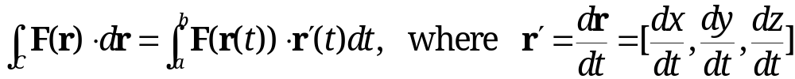
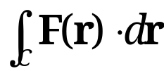
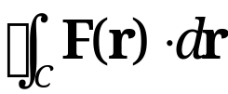
Review of Line and Double Integrals
A line integral of a vector function F(r)=[F₁(r), F₂(r), F₃(r)] over a curve C is defined by
where r(t), a ≤ t ≤ b, is a parametric representation of curve C
When C is a closed curve, is written as
Orientation of curve C: the direction from initial point A to terminal point B in which parameter t increases
General assumptions
  Integrand, vector function F(r), is continuous
  Integration path, curve C, is piecewise smooth

Slide 3
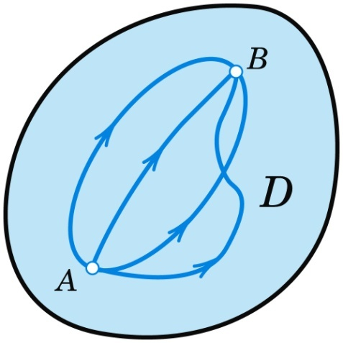
Review of Line and Double Integrals (cont’d)
(1)
The line integral (1) is path independent in a domain D in space if for every pair of endpoints A, B in domain D, (1) has the same value for all paths in D that begin at A and end at B.
Fig. 224. Path Independence

Slide 4
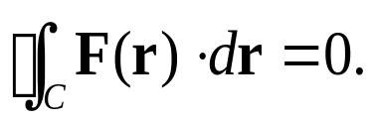
Review of Line and Double Integrals (cont’d)
Conditions for path independence: line integral (1) in a domain D is path independent if and only if:
F is a gradient field, i.e., F = grad f, where f is a scalar function (Theorem 1).
Integration around any closed curves C in D always gives 0 (Theorem 2):
curl F = 0, with D being simply connected (Theorem 3)
Remark: simple connectedness of the domain D is only needed in the last condition (i.e., Theorem 3)
Any closed curve in D

Slide 5
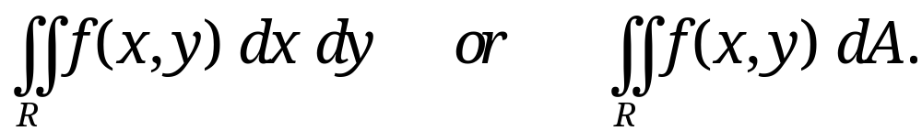
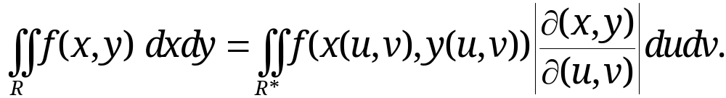
Review of Line and Double Integrals (cont’d)
A double integral of a scalar function f(x, y) over a closed bounded region R in the xy-plane is denoted by
Boundary curve of region R has a unique tangent at almost every point
Double integral is evaluated by two successive integrals
Change of variables: x=x(u, v) and y=y(u, v) :more info??
where R* is the region in the uv-plane corresponding to R in the xy-plane

Slide 6
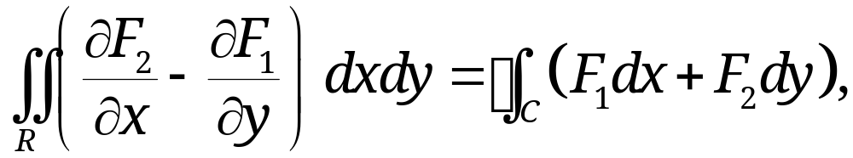
10.4 Green’s Theorem in the Plane
Theorem 1: Green’s Theorem in the Plane
(Relating Double Integrals to Line Integrals)
Let R be a closed bounded region in the xy-plane whose boundary curve C is piecewise smooth
Let F₁(x, y) and F₂(x, y) be continuous functions having continuous partial derivatives ∂F₁/∂y and ∂F₂/∂x everywhere in some domain containing region R.
Then, the following identity holds
(1)
where C is the entire boundary of R with the orientation that R is on the left as we move in the direction of integration (see Fig. 234).
Section 10.4 p<number>

Slide 7
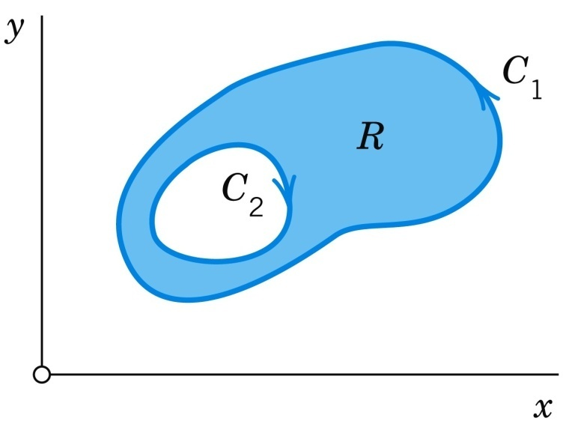
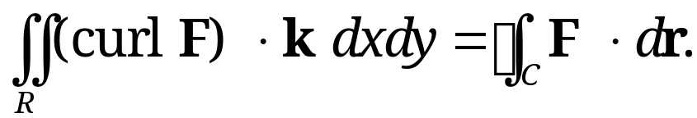
10.4 Green’s Theorem in the Plane
Theorem 1 (cont’d)
Fig. 234. Region R whose boundary C consists of two parts: C₁ is orientated counterclockwise, while C₂ is orientated clockwise in such a way that the region R is on the left for both curves
Setting F = [F₁(x,y), F₂(x,y) ] = F₁ i + F₂ j and putting in the vector form, we obtain (link to 3-D Stoke’s Theorem ??)
(1’)
Section 10.4 p<number>

Slide 8
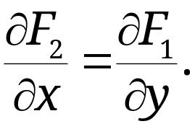
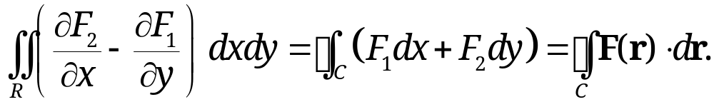
10.4 Green’s Theorem in the Plane
Recall Line Integral in 2D Plane of Section 10.2
Any F satisfying (6’’) in a simply connected region D will have path-independent line integrals
(6”)
Green’s theorem gives more general result:
That is, for any F not satisfying (6’’), then the difference of ∂F₂/∂x and ∂F₁/∂y integrated over the region R is equal to the line integral over the closed boundary C of region R.
Section 10.4 p<number>

Slide 9

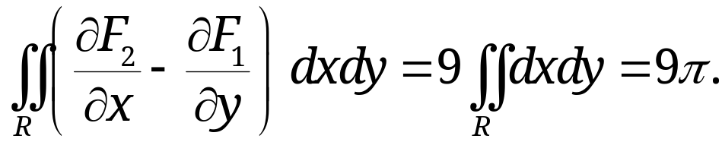
10.4 Green’s Theorem in the Plane
Verification of Green’s Theorem
[Detailed proof will be given in the tutorial 6]
Example 1: Consider the example where
F₁(x, y)=y²-7y, F₂(x,y)=2xy+2x, and boundary
curve C the circle x²+y²=1.
LHS of (1): ∂F₁/∂y=2y-7 and ∂F₂/∂x=2y+2.
RHS of (1): Curve C should be oriented counterclockwise. Let r(t)=[cos t, sin t], with 0≤t≤2π. Then, TODO: add more details, sin^n(x)/sin^n(x)cos^m(x) odd between 0 and 2PI thus integral is 0 …
Therefore, LHS of (1) = RHS of (1), verifying Green’s Theorem.
C
1
R
- 1
1
- 1
Section 10.4 p<number>

Slide 10
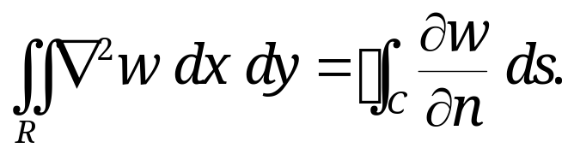
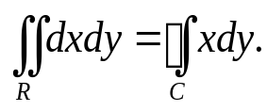

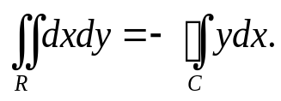
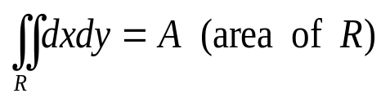

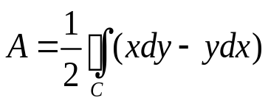
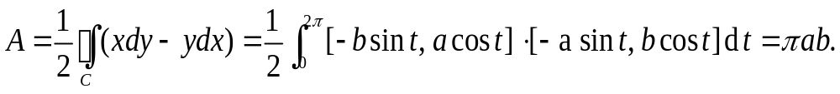
10.4 Green’s Theorem in the Plane
Some Applications of Green’s Theorem
Example 2: For any given region R with boundary C
Case 1: Choose F₁ =0 and F₂ =x,
Green’s theorem yields
Since , from the above equations we obtain:
(4)
Formula (4) expresses the area of region R in term of a line integral of the vector function F=[-y, x] over its boundary.
Exercise 1: For an ellipse x²/a² + y²/b² =1, which has a parametric representation r(t)=[a cos t, b sin t], with 0≤t≤2π . Calculate its area A.
Case 2: Choose F₁ = -y , F₂ = 0,
Green’s Theorem yields
Section 10.4 p<number>

Slide 11
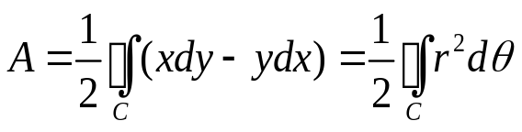
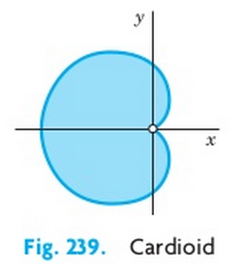
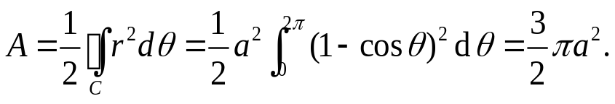
10.4 Green’s Theorem in the Plane
Some Applications of Green’s Theorem (cont’d)
Example 2: Area of a Plane Region in Polar Coordinates
Let r and θ be polar coordinates defined by x=r cosθ and y=r sinθ. Then,
Applying the chain rule, formula (4) becomes the well-known formula:
(5)
Exercise 2: Find the area of the cardioid with
the boundary curve r =a (1- cosθ), with 0≤ θ ≤2π.
Solution: Its area A is given by
C
a
-a
-a
Section 10.4 p<number>
Notes:
First break

Slide 12
10.5 Surfaces
for Surface Integrals

Slide 13
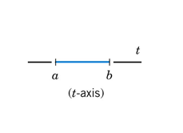
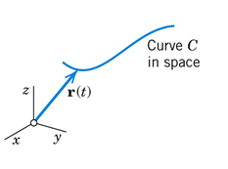
10.5 Surfaces for Surface Integrals
Parametric Representation of Curves
For a curve C in line integrals, it is more practical and flexible to employ a parametric representation:
r(t) = [x(t), y(t), z(t)], with a ≤ t ≤ b.
This maps every parameter t in interval [a, b] onto a point of curve C with position vector r(t).
Fig. 241(A). Parametric representation of a curve
Section 10.5 p<number>

Slide 14
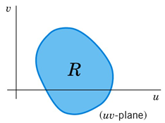
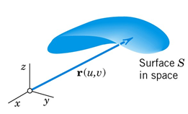
10.5 Surfaces for Surface Integrals
Parametric Representation of Surfaces
For a surface S in surface integrals, it is more practical and flexible to employ a parametric representation. Since surfaces are two-dimensional, we need two parameters u and v.
A parametric representation of a surface S in space is of the form:
(2) r(u, v) = [x(u, v), y(u, v), z(u, v)],
where (u, v) varies in some region R of the uv-plane. This maps every (u, v) in R onto a point of S with position vector r(u, v)
Fig. 241(B). Parametric representation of a surface
Section 10.5 p<number>

Slide 15
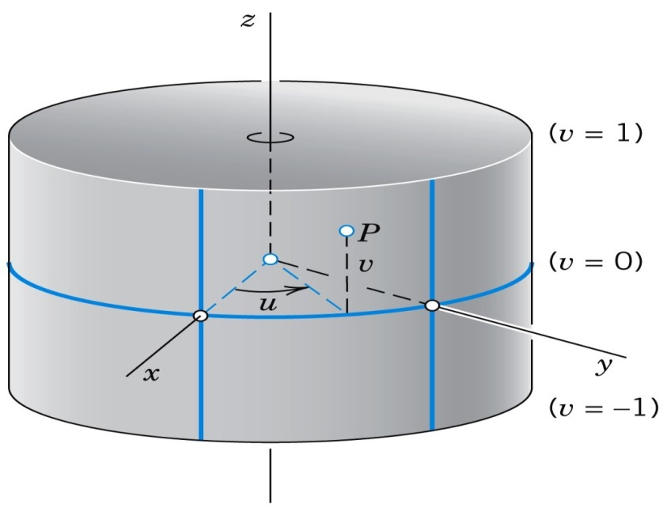
10.5 Surfaces for Surface Integrals
EXAMPLE 1
Parametric Representation of a Cylinder
The circular cylinder x² + y² = a², –1 ≤ z ≤ 1, has radius a, height 2, and the z-axis as axis.
Fig. 242. Parametric representation of a cylinder
Section 10.5 p<number>

Slide 16
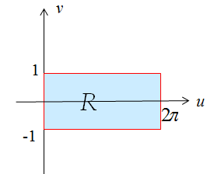
10.5 Surfaces for Surface Integrals
EXAMPLE 1 - Solution
A possible parametric representation (Fig. 242):
r(u, v) = [a cos u, a sin u, v] = a cos u i + a sin u j + v k
The parameters u and v vary in the
rectangle R:
0 ≤ u ≤ 2π, –1 ≤ v ≤ 1
in the uv-plane.
Region of u and v
The curves u = constant are vertical straight lines; while the curves v = constant are parallel circles.
Remark: in this example x and y cannot serve as the parameters to represent the surface.
Section 10.5 p<number>

Slide 17



10.5 Surfaces for Surface Integrals
EXAMPLE 2
Parametric Representation of a Sphere
A sphere x² + y² + z² = a² can be parametrized by choosing
x = a cos v cos u, y = a cos v sin u, z = a sin v.
Then, the surface is represented in the form
(3) r(u, v) = a cos v cos u i + a cos v sin u j + a sin v k.
The parameters u and v vary in the
rectangle R in the uv-plane given
by 0 ≤ u ≤ 2π, –π/2 ≤ v ≤ π/2.
Region of u and v
v
R
a
u
Section 10.5 p<number>

Slide 18
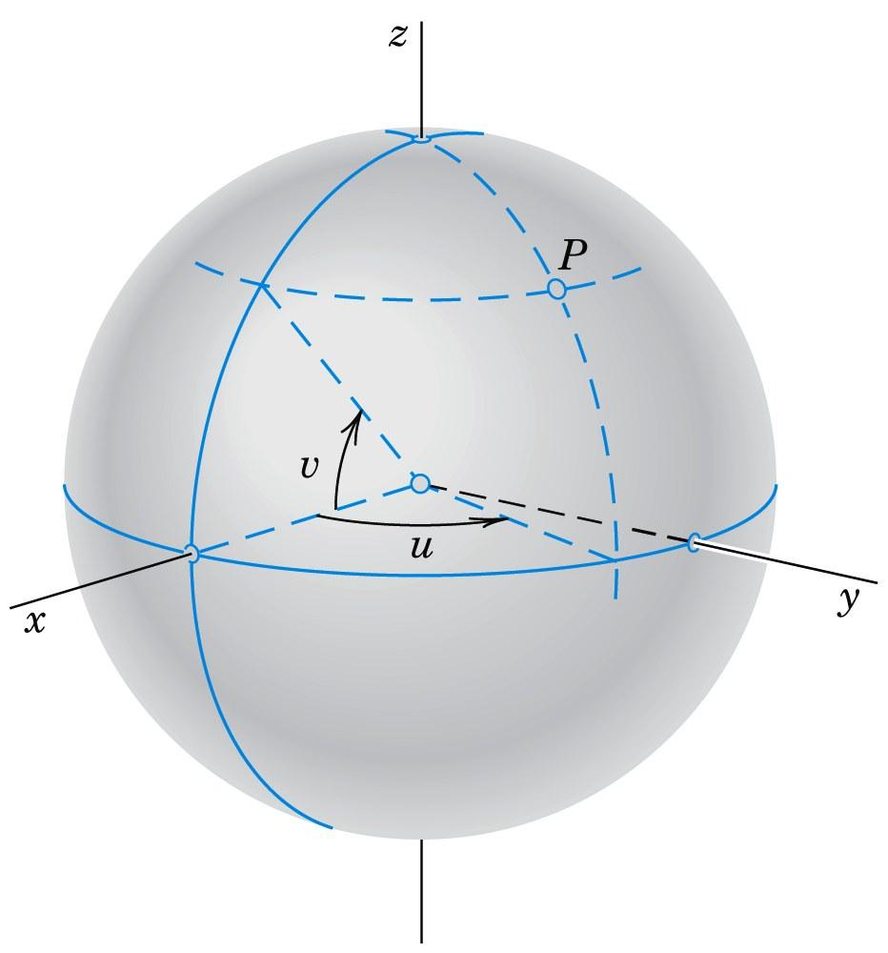
10.5 Surfaces for Surface Integrals
EXAMPLE 2 (cont’d)
The curves u = const and v = const are the “meridians” and “parallels” on S (see Fig. 243). This is the longitude and latitude representation used in geography.
Region of u and v
Fig. 243. Parametric representations of a sphere
Constant v line
v
u
Constant u line
v
R
a
u
Section 10.5 p<number>

Slide 19
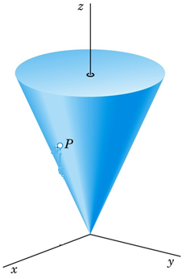
10.5 Surfaces for Surface Integrals
EXERCISE
Parametric Representation of a Cone
Find a parametric representation of a circular cone
x²+y² -z²=0 with 0 ≤ z ≤ H.
Solution: r(u, v) = [u cos v, u sin v, u]
= u cos v i + u sin v j + u k
or in components x = u cos v, y = u sin v, z = u.
And the parameters vary in the rectangle
R: 0 ≤ u ≤ H, 0 ≤ v ≤ 2π.
Question: what are the curves u = const and v = const?
Section 10.5 p<number>

Slide 20










10.5 Surfaces for Surface Integrals
Tangent Plane and Surface Normal
Recall from Chapter 9 parametrization of curve C with respect to t.
Extension to surface S parametrized with u and v
Tangent line at P:
•
P
•
S
C
•
P
z
z
y
x
y
x
Section 10.5 p<number>

Slide 21
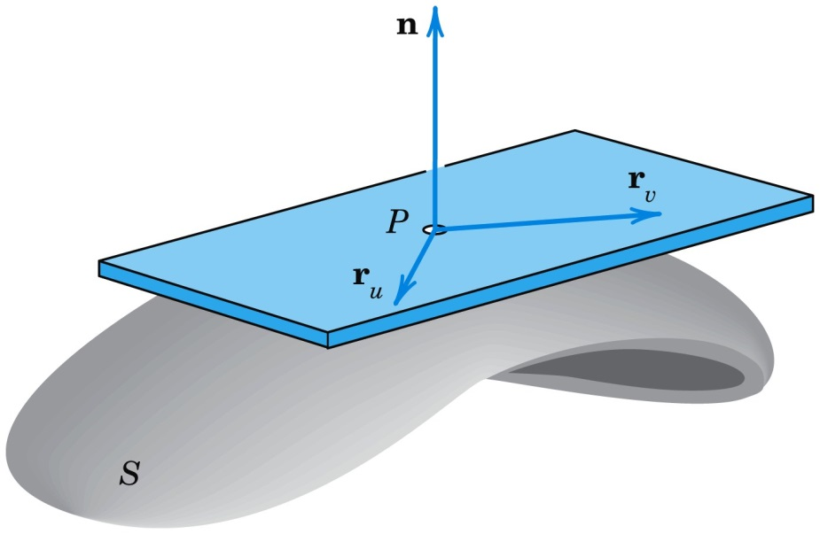
10.5 Surfaces for Surface Integrals
Tangent Plane and Surface Normal
Recall from Sec. 9.7 that the tangent vectors of all the curves on a surface S through a point P of S form a plane, called the tangent plane of S at P (Fig. 244).
A vector perpendicular to the tangent plane is called a normal vector of S at P.
Fig. 244. Tangent plane and normal vector
Section 10.5 p<number>

Slide 22

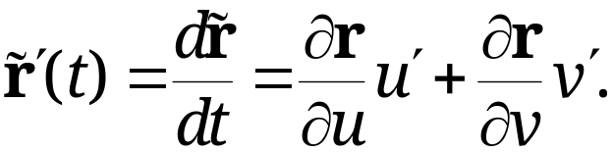
10.5 Surfaces for Surface Integrals
Tangent Plane and Surface Normal (continued)
Since S can be given by r = r(u, v) in (2), the new idea is that we get a curve C on S by taking a pair of differentiable functions
u = u(t) and v = v(t)
whose first derivatives u’(t) and v’(t) are continuous.
Then, curve C has the position vector
By differentiation and the use of the chain rule (Sec. 9.6) we obtain a tangent vector of C on S
Section 10.5 p<number>

Slide 23
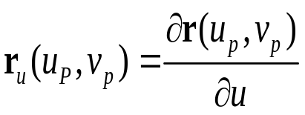

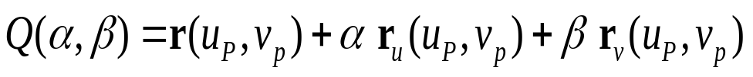
Tangent Plane
10.5 Surfaces for Surface Integrals
Partial derivatives r_{u} and r_{v} at P are tangential to S at P.
is the partial derivative of r(u,v) with
respect to u when (u, v)=(u_{p}, v_{p}). It lies on the constant v lines of the surface.
Similarly, is the partial derivative of r(u,v)
with respect to v when (u, v)=(u_{p}, v_{p}). It lies on the constant u lines of the surface. TODO: fix r_{uv} as r’_{uv} ??
If r_{u} and r_{v} at P are linearly independent, then the tangent plane of S at point P is spanned by vectors r_{u} and r_{v}:
where α and β are two parameters, with -∞<α, β<+∞.
Section 10.5 p<number>

Slide 24
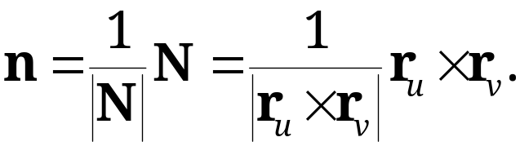
10.5 Surfaces for Surface Integrals
Surface Normal
Moreover, the cross product of r_{u} and r_{v} gives a normal vector N of S at P:
(4) N = r_{u} × r_{v} ≠ 0.
The corresponding unit normal vector n of S at P is
(5)
Remark: if we exchange the variables u and v in our initial parametrization, then the direction of vector n obtained will be reversed. Both are normal vector to S, as a surface has two normal directions.
Section 10.5 p<number>

Slide 25


10.5 Surfaces for Surface Integrals
Tangent Plane and Surface Normal
Fig. 244. Tangent plane and normal vector
Tangent Plane
constant u line
constant v line
Section 10.5 p<number>

Slide 26
EXERCISE
Unit Normal Vector of a Sphere
10.5 Surfaces for Surface Integrals
Find the tangent plane and the unit normal vector of the sphere x² + y² + z² = a² at point P: (x, y, z).
Solution:
The sphere can be parametrized by, with 0 ≤ u ≤ 2π and –π/2 ≤ v ≤ π/2:
r(u, v) = a cos v cos u i + a cos v sin u j + a sin v k.
Then,
r_{u}(u, v) = -a cos v sin u i + a cos v cos u j + 0 k,
r_{v}(u, v) = -a sin v cos u i - a sinv sin u j + a cos v k.
Thus, TODO: add detailed derivation
Section 10.5 p<number>

Slide 27
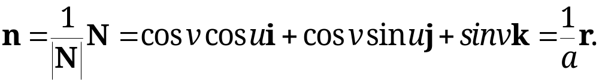
EXERCISE
Unit Normal Vector of a Sphere
10.5 Surfaces for Surface Integrals
Solution (cont’d): TODO: Q(), (a^2-z^2) missing \sqrt(), den. Term in r_v(P) missing
The tangent plane of the sphere at point P is given by
We next find the unit normal vector n:
N(u, v) = r_{u} × r_{v}
= a² cos² v cos u i + a² cos² v sin u j+ a² cos v sin v k
|N(u, v)|= a² cos v
Thus, the unit normal vector n is given by
Section 10.5 p<number>

Slide 28

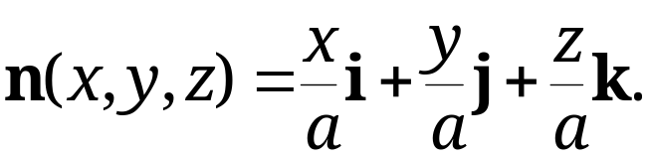
10.5 Surfaces for Surface Integrals
Converting to x, y, and z
parameters, we have
Note that r_{u} and r_{v} are along the constant lines of v and u at P, respectively.
In this parametrization of u and v, the resulting n has the direction of the position vector [x, y, z] of P.
Constant v line
n
r_{v}
r_{u}
u
Constant u line
v
Section 10.5 p<number>

Slide 29
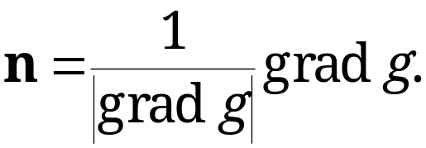
10.5 Surfaces for Surface Integrals
Another Derivation of Surface Normal
If S is represented by g(x, y, z) = 0, then, by Theorem 2 in Sec. 9.7,
(5*)
is normal to the surface S at point P pointing in the
increasing direction of g(x, y, z).
Note: if we characterize S as g’(x, y, z )= - g(x, y, z) = 0, the resulting n will be in the reverse direction.
The above two methods of obtaining surface normal may differ by a negative sign due to their characterization.
Section 10.5 p<number>

Slide 30
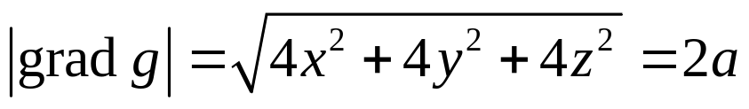
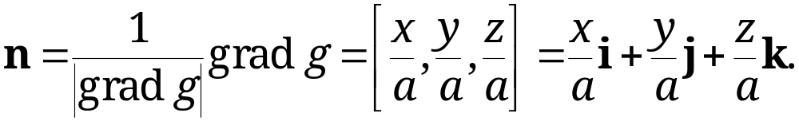
EXAMPLE 4 Revisited
Unit Normal Vector of a Sphere
10.5 Surfaces for Surface Integrals
The sphere x² + y² + z² = a² can be expressed as
g(x, y, z )= x² + y² + z² - a² = 0.
Taking gradient of g(x, y, z), we obtain
grad g = 2x i + 2y j + 2z k
Hence,
Note: if we characterize the sphere as:
g’(x, y, z )= - x² -y² -z² + a² = 0,
then the resulting n will be in reverse direction.
same result!
Section 10.5 p<number>

Slide 31
10.5 Surfaces for Surface Integrals
Theorem 1
Tangent Plane and Surface Normal
If a surface S is given by
(2) r(u, v) = [x(u, v), y(u, v), z(u, v)],
with continuous r_{u} = ∂r/∂u and r_{v} = ∂r/∂v satisfying
(4) N = r_{u} × r_{v} ≠ 0
at every point of S, then S has, at every point P,
  a unique tangent plane passing through P and spanned by r_{u} and r_{v}
  a unique normal whose direction depends continuously on the points of S
  A normal vector given by (4) and the corresponding unit normal vector by (5) (See Fig. 244)
Section 10.5 p<number>

